Slide 1
Aerosol Profiling during CINDI
Udo Frieß
Henk Klein Baltink
Katrijn Clémer
Udo Frieß
Hitoshi Irie
Tim Vlemmix
Thomas Wagner
Folkard Wittrock
Selami Yilmaz
Paul Zieger

Slide 2
The Aerosol Retrieval Group
Institute | Quantities retrieved | Input data | Vertical gridding | Status
BIRA | Extinction profile | O₄ dSCDs @ single wavelength | 200 m | Data for most of the period
Bremen | AOT+ Layer height | O₄ dSCDs @ single wavelength | n/a | No data yet
Heidelberg | Extinction profile and optical properties | O₄ dSCDs (optionally: relative intensities @ several wavelengths) | 200 m | Data for selected days
KNMI | AOT | Relative intensity @ single wavelength | n/a | Data for selected days
MPI | AOT+ Layer height | O₄ dSCDs @ single wavelength | n/a | Data for most of the period
JAMSTEC | Extinction profile | O₄ dSCDs @ single wavelength | 1 km | Data for most of the period

Slide 3
Aerosol Instrumentation during CINDI
Institute | Instrument | Quantities
RIVM | Backscatter Lidar | Backscatter profiles
KNMI | Vaisala CT75 Ceilometer | Backscatter profiles
RIVM | CAELI Raman Lidar | Backscatter and extinction profiles
PSI | Humidity controlled Nephelometer | Surface extinction coefficient
TNO | Multi Angle Absorption Photometer | Black carbon
TNO | CIMEL Sun Photometer | AOT

Slide 4
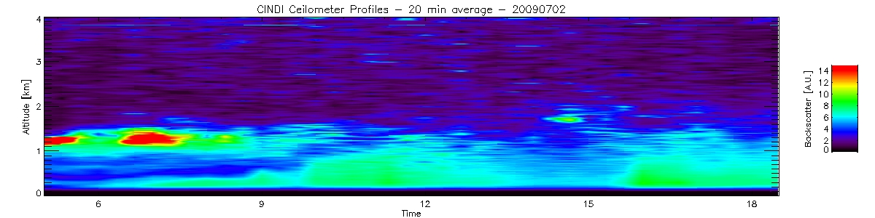
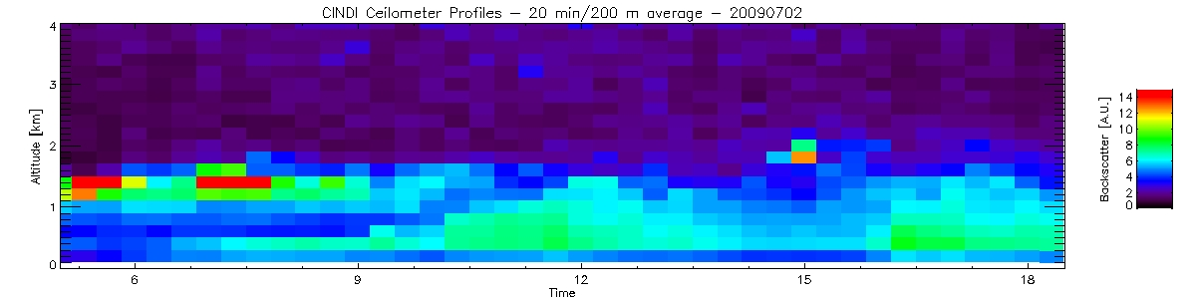
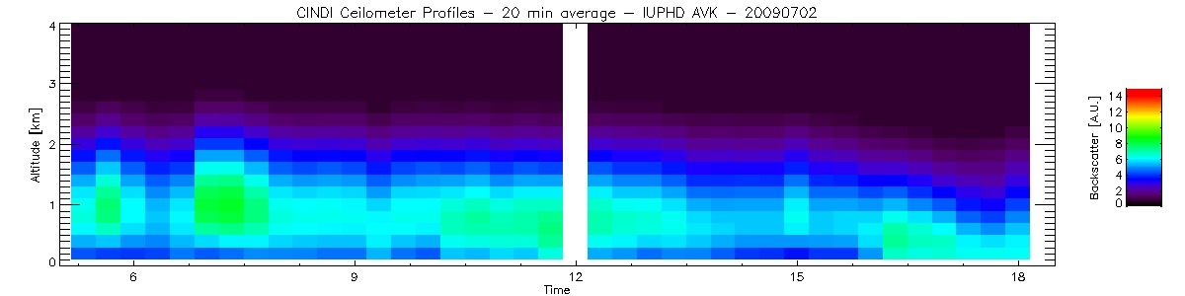
Treatment of Backscatter Profiles
Full vertical resolution (~7.5 m)
20 min average
200 m average
Artificial degradation to MAX-DOAS vertical resolution by applying Averaging Kernel (IUPHD)

Slide 5
Data Intercomparison
All data converted to 477 nm using Ångstrom exponent from Sun photometer (except Ceilometer, 905 nm)
→ Disadvantage for MPI (360 nm), but no Sun Photometer data available below 440 nm
Comparison restricted to Golden Days:
  23., 24., 25., 30. June & 1., 2., 3., 4. July

Slide 7
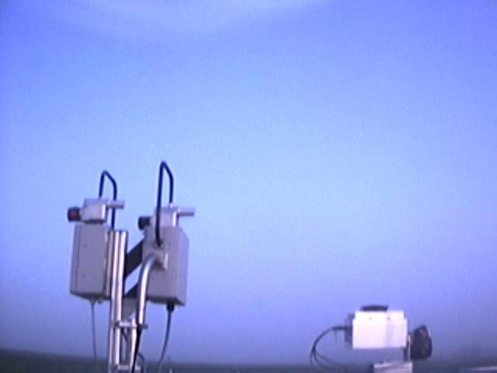
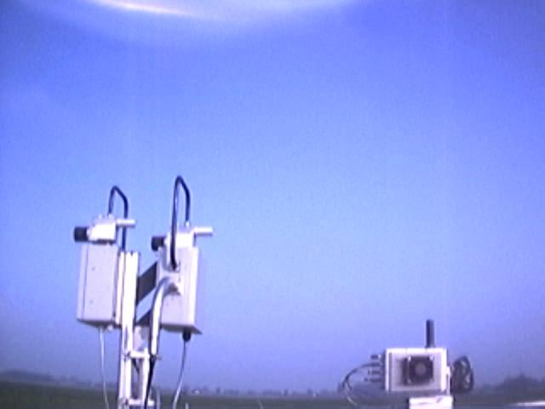
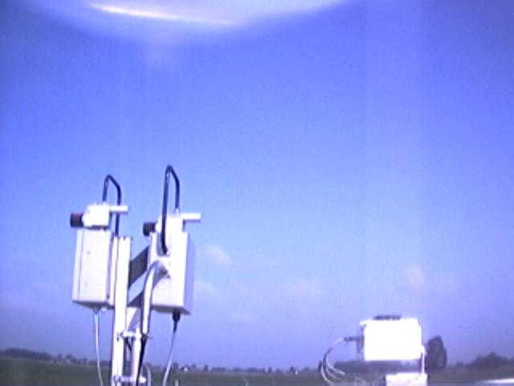
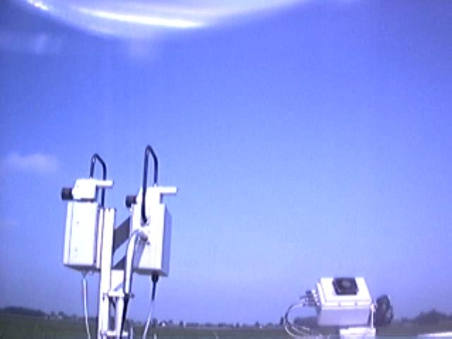
30.06.09 05:08
30.06.09 06:09
30.06.09 07:00
30.06.09 08:00

Slide 10
CINDI Campaign
Comparison with Nephelometer and Sun Photometer

Slide 11
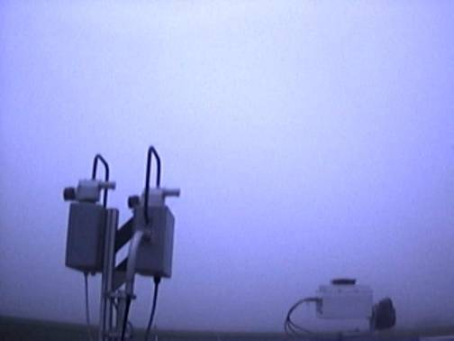
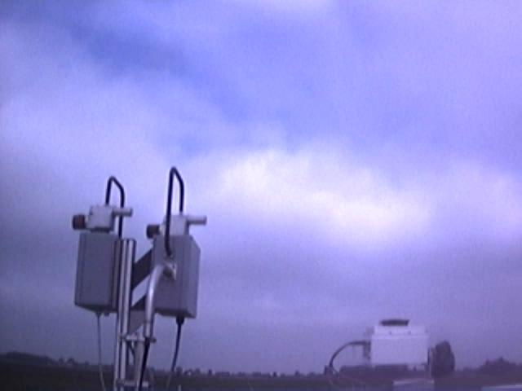
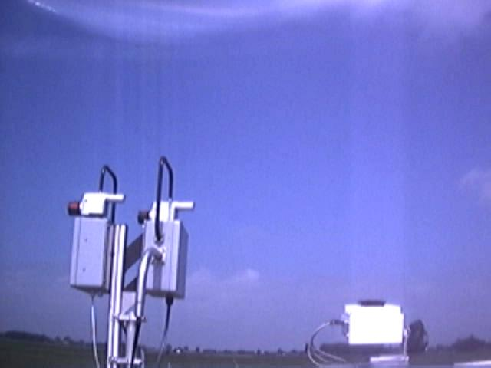
CINDI Campaign
Comparison with Nephelometer and Sun Photometer
Data excluded from intercomparison

Slide 12
AOT – Correlation with Sun Photometer
- All data converted to 477 nm using Ångström Exponent from Sun Photometer -
427 -> 477 nm
Participant | Regression coefficient | Slope | Intercept
BIRA | 0.80 | 0.70 | 0.02
IUPHD | 0.87 | 0.80 | 0.03
JAMSTEC | 0.86 | 0.90 | 0.04
KNMI | 0.87 | 1.21 | -0.04
MPI | 0.81 | 0.62 | 0.04
360 -> 477 nm

Slide 13
Summary
Vertical structure of boundary layer as retrieved from MAX-DOAS is in very good agreement with backscatter profiles from Ceilometer, especially for BIRA and IUPHD
AOD in good agreement with Sun Photometer for most groups
Comparison of data at 477 nm with measurements at other wavelengths (MPI, 360 nm) problematic; no Sun Photometer data below 440 nm
Systematically higher surface extinction than WetNeph in the afternoon remains unresolved, huge discrepancies
Each of the algorithms and different approaches has its individual advantages/shortcomings (vert. resolution, robustness, …)
Write-up of paper is in progress….

